Slide 1
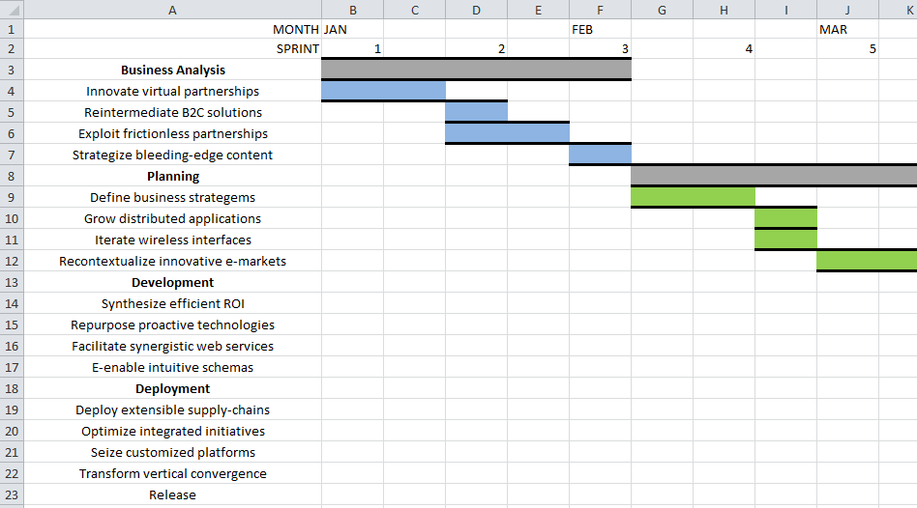
Oregon Roadmap

Slide 2
Oregon Roadmap design
Based off of the popular edutainment game ‘Oregon Trail’
Designed to simulate the agile process, including sprints, story points, scrum teams, etc
You start by hiring a team of staff to work on a product
Events occur and you have to accumulate and spend story points to complete tasks, whilst keeping morale high
At the end of the game, you are scored based on number of tasks completed and overall team morale
If your score is too low, you go bankrupt

Slide 3
React.js
React is a JavaScript library for creating user interfaces by Facebook and Instagram
Used to solve issues that come with updating the UI for large applications with data that is constantly changing
This is basically the exact opposite of the small, state-based game we decided to make

Slide 4
It was a bloody nightmare

Slide 5
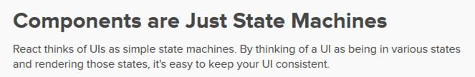
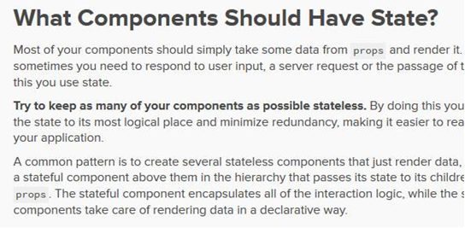
Here’s why

Slide 6
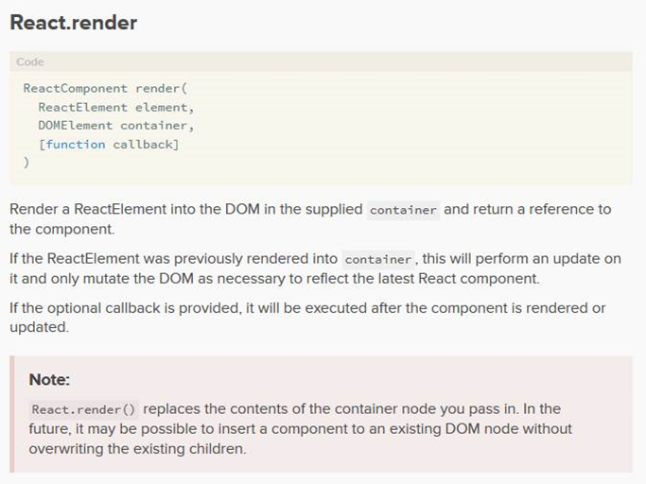
And all you do is render

Slide 7
Questions?

